Slide 1
The Pursuit of Happiness
Jeffrey Baron
DSC 530 Prof. Fadi Alsaleem

Slide 2

What is Happiness?
The Pursuit of Happiness
MRI-Simmons’ “Survey of the American Consumer”
asks this question:
I am happy with my
standard of living:
Agree Strongly
Agree Somewhat
Disagree Somewhat
Disagree Strongly
But what is the root of happiness?

Slide 3
The Contenders
The Pursuit of Happiness
Health
Correlate with “I am Satisfied with my Weight”
I make sure I take time for myself each day
Keeping a neat, organized home is a top priority
I have a better fashion sense than most people
I feel I am more environmentally conscious than most people
I often choose methods of transportation that are friendlier to the environment

Slide 4
The Contenders
The Pursuit of Happiness
Wealth
Correlate with Annual Household Income
I consider my work to be a career, not just a job
I am more capable than most peopleority
I enjoy entertaining people in my home
My friends and acquaintances look to me to organize our activities
I often find myself in a leadership position

Slide 5
The Contenders
The Pursuit of Happiness
Love
Correlate with “Spending time with my family is my top priority”
I frequently wish I had more time to spend with family
I often indulge my children with little extras
It's important to me that my children continue family cultural traditions
I enjoy maintaining traditions
I prefer a set routine in my daily life

Slide 6
The Contenders
The Pursuit of Happiness
Faith
Correlate with “Hold to Religious Belief”
Prayer is a part of my daily life
Religion should be the pillar of our society
I believe in the biblical teaching that God created the world in six days
I consider myself a spiritual person
I attend religious services regularly

Slide 7
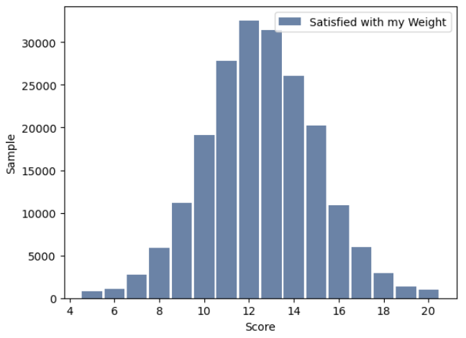
Health
The Pursuit of Happiness
The sum of the answers to the health questions produces a normal distribution with a positive right skew, with outliers at the high end who are particularly health conscious. Based on this, more people are less healthy.
key n mean mode var std cv
All Yrs 201216 12.52 12.00 6.32 2.51 0.2009
2021 23964 12.59 13.00 4.88 2.21 0.1754
2022 48668 12.50 12.00 6.25 2.50 0.2000
2023 51409 12.55 12.00 6.54 2.56 0.2038
2024 51480 12.47 12.00 6.68 2.58 0.2072
Skew: 0.0451

Slide 8
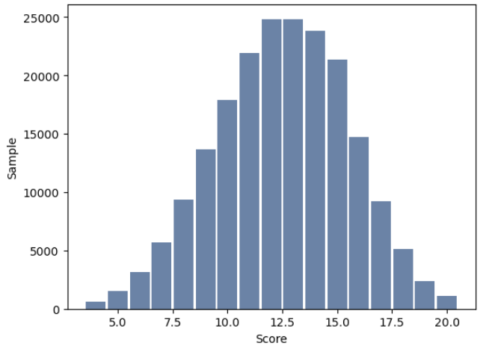
Wealth
The Pursuit of Happiness
Answers to wealth-correlated questions produce a negatively skewed distribution. More people are making more money.
key n mean mode var std cv
All Yrs 201216 12.49 13.00 9.13 3.02 0.2419
2021 23964 12.71 12.00 7.68 2.77 0.2181
2022 48668 12.57 12.00 9.06 3.01 0.2395
2023 51409 12.46 12.00 9.36 3.06 0.2456
2024 51480 12.38 13.00 9.32 3.05 0.2466
Skew: -0.1280

Slide 9
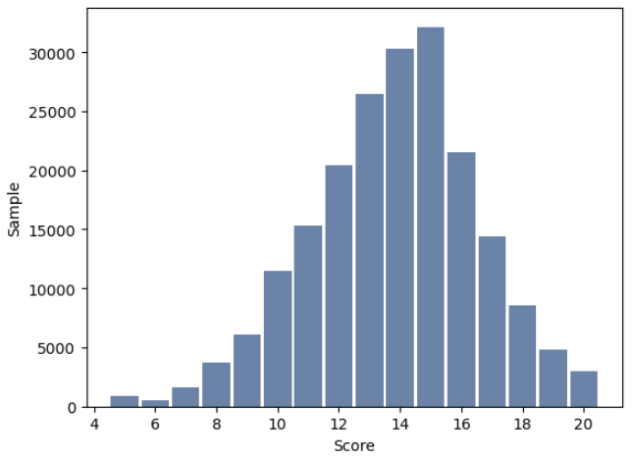
Love
The Pursuit of Happiness
The mode of love-correlated questions
is higher than the others, but with a more negative skew, more people report less love in their lives.
key n mean mode var std cv
All Yrs 201216 13.79 15.00 7.49 2.74 0.1984
2021 23964 13.85 15.00 6.53 2.56 0.1845
2022 48668 13.80 15.00 7.34 2.71 0.1962
2023 51409 13.77 15.00 7.74 2.78 0.2020
2024 51480 13.79 15.00 7.63 2.76 0.2004
Skew: -0.2626

Slide 10
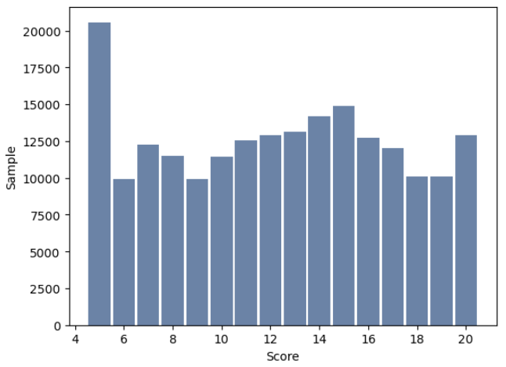
Faith
The Pursuit of Happiness
Faith-correlates are all over the map, but unlike the others, while the mean has stayed constant over the past four years, the mode has dropped from 8 to 5 during that period.
key n mean mode var std cv
All Yrs 201216 12.28 5.00 21.78 4.67 0.3801
2021 23964 12.16 8.00 17.97 4.24 0.3485
2022 48668 12.25 5.00 22.78 4.77 0.3896
2023 51409 12.24 5.00 22.33 4.73 0.3862
2024 51480 12.33 5.00 22.00 4.69 0.3806
Skew: -0.01872

Slide 11
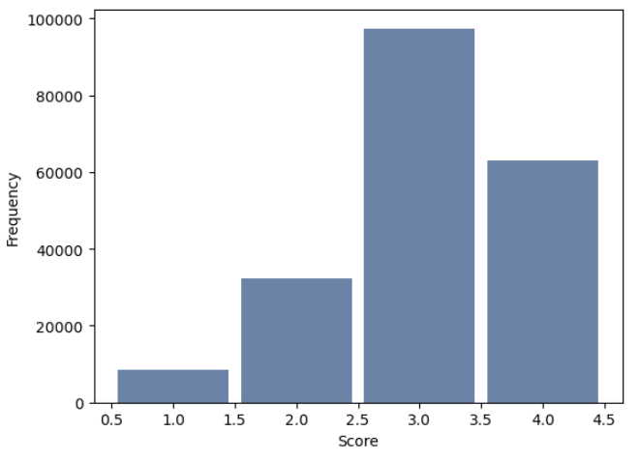
Happiness
The Pursuit of Happiness
Most people agree
that they are happy
with their standard of
living. Their scores
have been consistent
for years. But why?
What makes a person
“Happy”?
key n mean mode var std cv
All Yrs 201216 3.07 3.00 0.64 0.80 0.2609
2021 23964 3.13 3.00 0.56 0.75 0.2392
2022 48668 3.12 3.00 0.60 0.77 0.2478
2023 51409 3.06 3.00 0.66 0.81 0.2660
2024 51480 3.03 3.00 0.67 0.82 0.2704
Skew: -0.6242

Slide 12
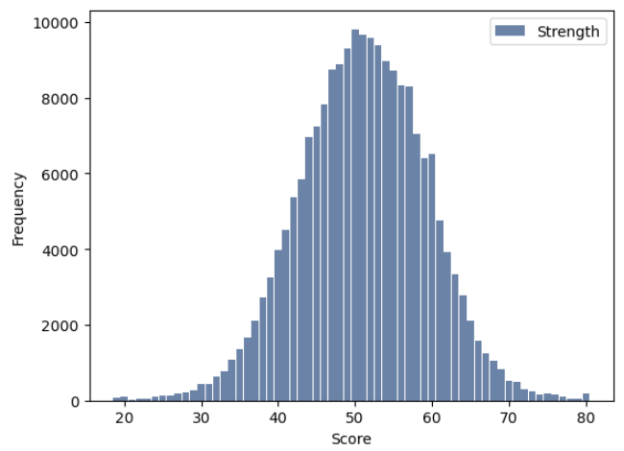
“Strength”
For the next few slides,
we’ll look at the four
factors consolidated
into a single measure,
which will be referred
to as “Strength”. This
score has declined
slightly in recent years.
key n mean mode var std cv
All Yrs 201216 51.08 50.00 68.18 8.26 0.1616
2021 23964 51.31 51.00 49.78 7.06 0.1375
2022 48668 51.13 51.00 68.10 8.25 0.1614
2023 51409 51.01 51.00 71.41 8.45 0.1657
2024 51480 50.96 50.00 70.99 8.43 0.1653
Skew: -0.0685
Kurtosis: 0.2464

Slide 13
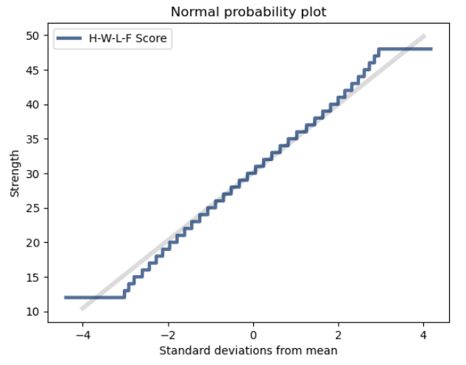
“Strength”
The Pursuit of Happiness
This probability plot shows that “strength”, being the sum of a person’s health, wealth, love, and faith scores, is an almost perfectly normal distribution.

Slide 14
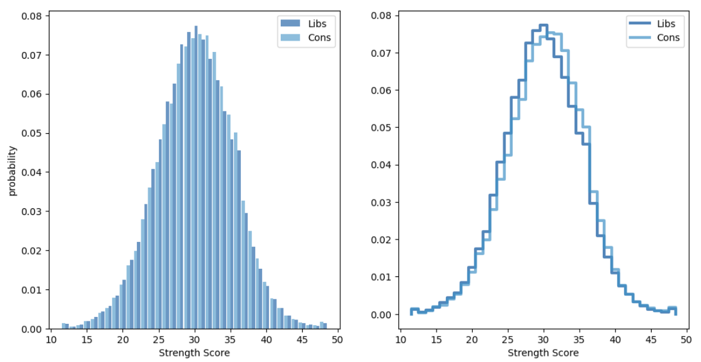
Politics?
The Pursuit of Happiness
There’s been a lot of focus on politics recently, so let’s compare Democrats and Republicans:
Conservatives appear to have a slight strength advantage, but…

Slide 15
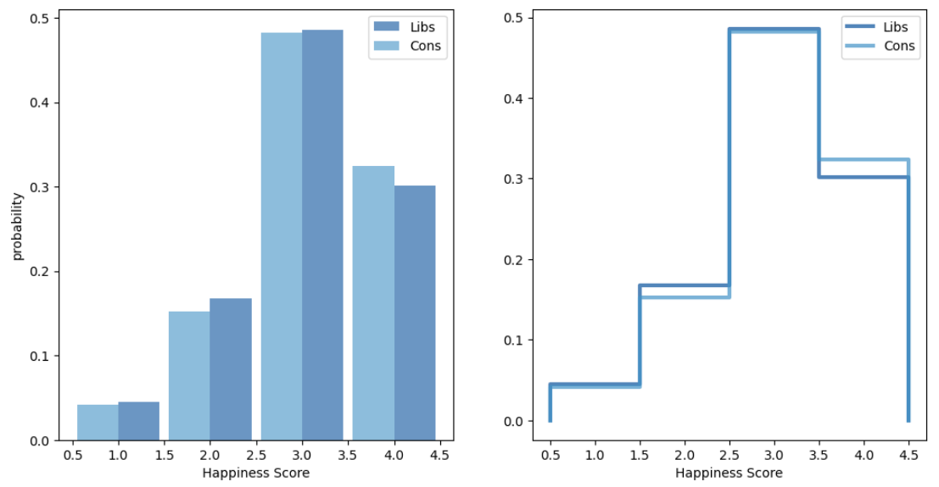
Politics?
The Pursuit of Happiness
…When it comes to happiness, the difference between liberals and conservatives is negligible.

Slide 16
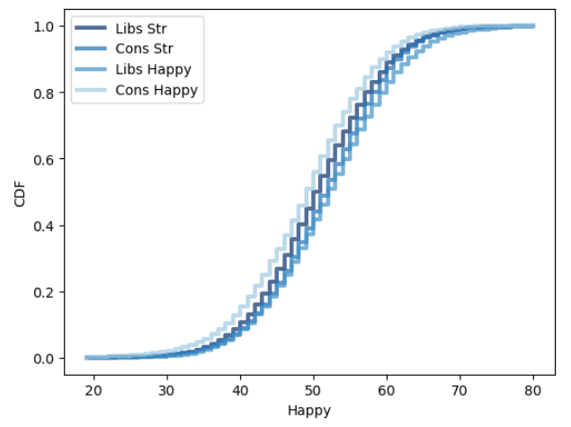
Politics?
The Pursuit of Happiness
It’s pretty clear that liberals
and conservatives are not
all that different in terms of
the these attitudes.

Slide 17
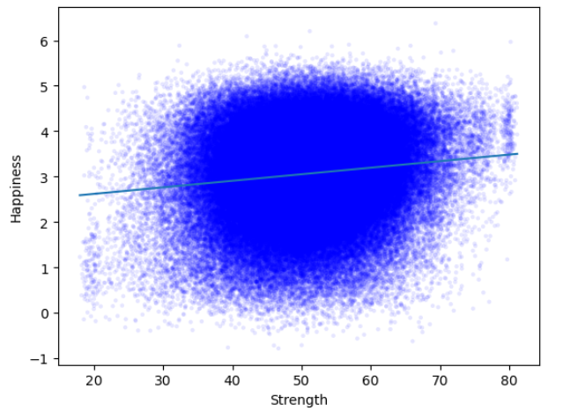
Correlation
The Pursuit of Happiness
Plotting the Strength
variable shown before
vs. happiness, it’s clear
that there isn’t much of
a correlation between
these two general
measures.
Correlation: 0.1505
Spearmans Corr: 0.1292

Slide 18
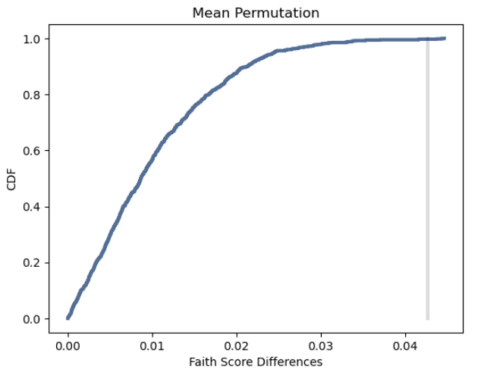
Losing Our Religion
The Pursuit of Happiness
As an aside, it’s clear (for a .002 p-value) that the mean faith score has been dropping between 2021and 2024.

Slide 19
Overthinking It…
The Pursuit of Happiness
Looking at the regression analysis, it’s clear that general attitudes don’t correlate well with happiness:
Factor | Coefficient (R²)
Health | 0.011130
Wealth | 0.033594
Love | 0.003166
Faith | 0.012808
All P-Values = 0

Slide 20
Overthinking It…
The Pursuit of Happiness
In contrast, a few specific attitudinal questions correlate very well, and come closer to answering our question: What makes us happy?
Question | Coefficient (R²)
It is important to continue learning new things | 0.222244
I often do things on the spur of the moment | 0.148704
On the whole, people get what they deserve in life | 0.104581
I am an optimist | 0.090982
I enjoy entertaining people in my home | 0.082823
All P-Values = 0

Slide 21
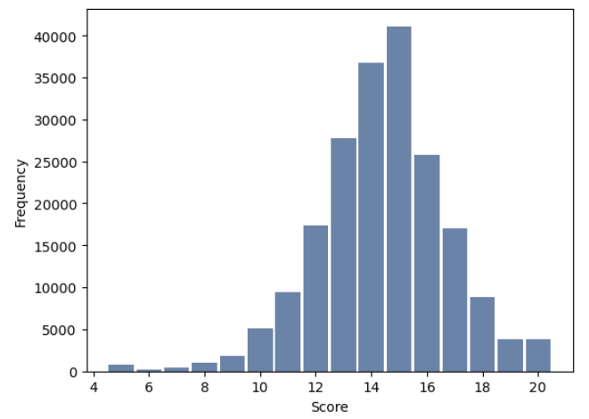
Putting It All Together
The Pursuit of Happiness
Happiness is an elusive
trait. You’ll find it, not in
the grand measures of
health, wealth, love, or
faith, but in the small
measurements that only
become apparent with
detailed analysis.
key n mean mode var std cv
All Yrs 201216 14.41 15.00 5.42 2.33 0.1616
2021 23964 14.49 15.00 4.83 2.20 0.1517
2022 48668 14.48 15.00 5.04 2.25 0.1551
2023 51409 14.38 15.00 5.57 2.36 0.1642
2024 51480 14.36 15.00 5.67 2.38 0.1659
Skew: -0.33384306226253624
Kurtosis: 1.0775

